Slide 1


Building digital workplaces with Dataverse for Microsoft Teams by Tomasz Poszytek, MVP
collabdays | lisbon
November 13th, 2021

Slide 2

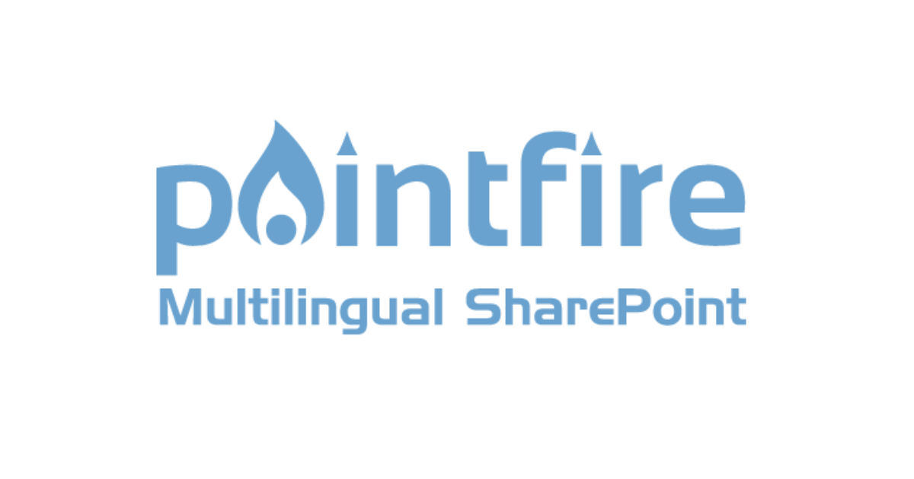



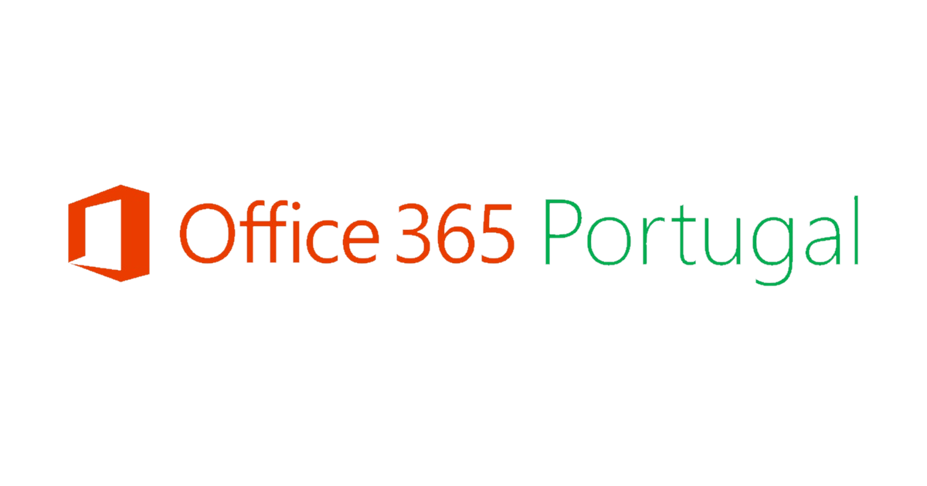

Our Sponsors
GOLD
COMMUNITY

Slide 3



About me
Tomasz Poszytek, Business Applications MVP
Specialist in enabling organizations to work more effectively through optimizing their business processes.
Experienced expert who works for over 10 years with SharePoint and over 4 with Office 365 and Power Platform.
Continuously learning to stay up-to-date with latest changes. Loves sharing knowledge with customers and community members.
#PowerAddict for life! ☺
https://aka.ms/poszytek

Slide 4
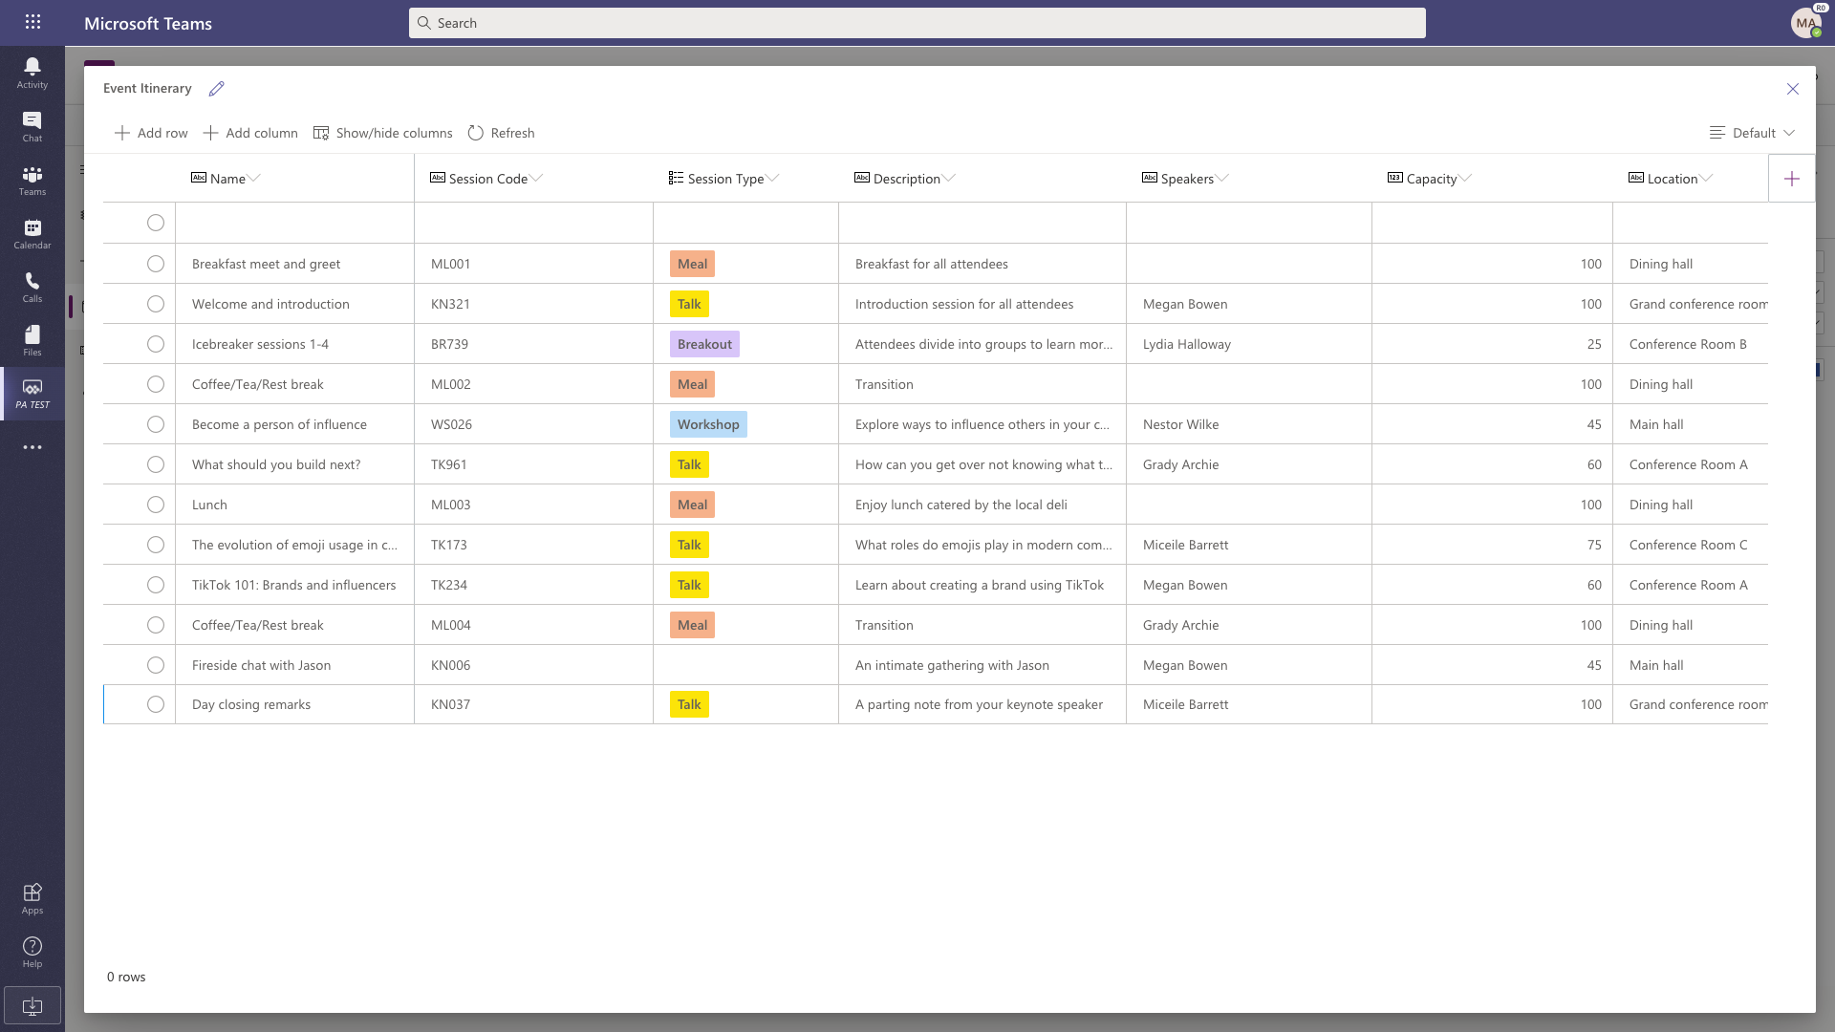




Microsoft Dataverse for Teams
A built-in low code data platform for Microsoft Teams.
A subset of the capabilities of the data platform behind Dynamics 365 and Power Platform.
Provides storage, rich data types with enterprise capabilities, and one-click solution deployment.
Included for every Teams customer, governable by IT.

Slide 5
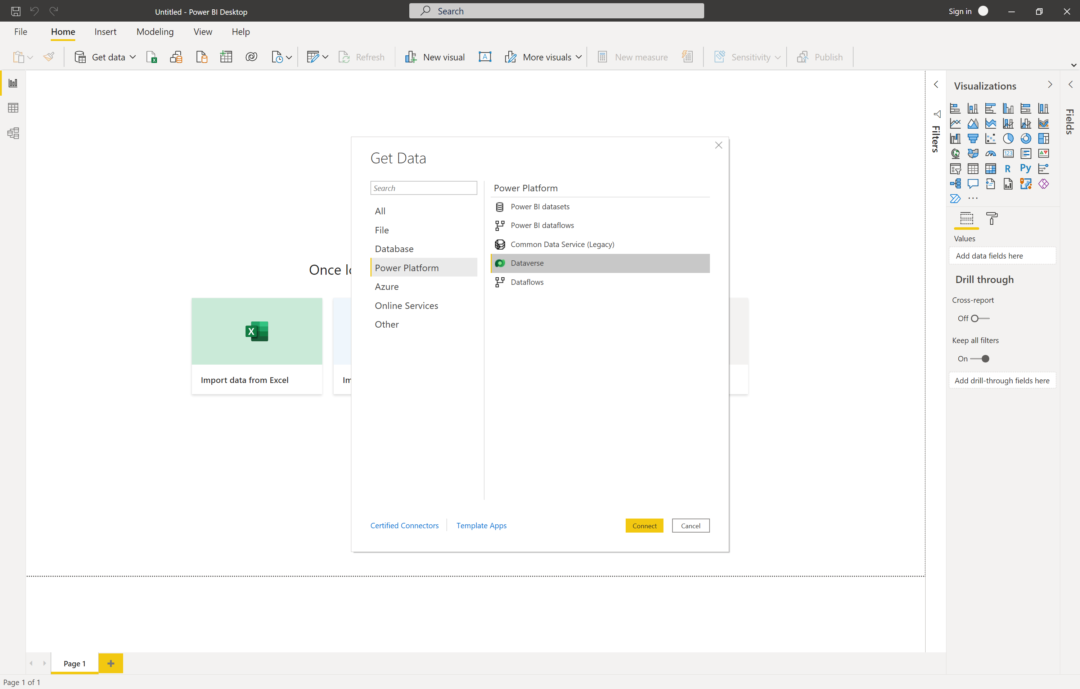
Dataverse for Teams can connect to Power BI
Dataverse for Teams has a TDS endpoint enabled for use with Power BI
Licensed PBI users can now create reports built on data in Dataverse for Teams
SQL
Queries for reports can be written in SQL

Slide 6
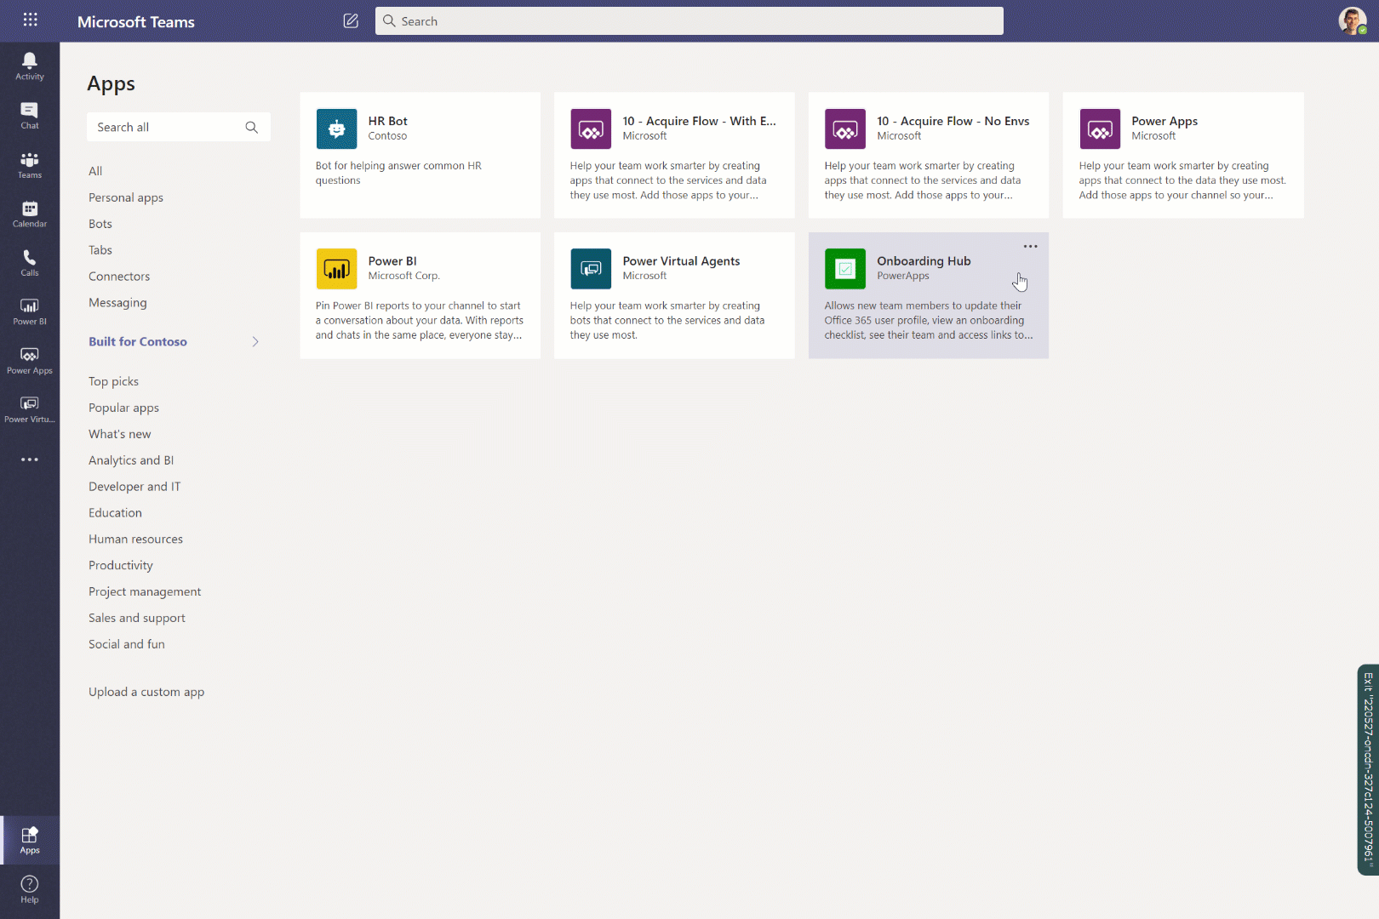


Install Power Platform solutions into Teams with a single click
Teams users can find and install custom solutions in the Teams app store.
Citizen developers or partners can now easily put their solutions where Teams users know where to look.

Slide 7

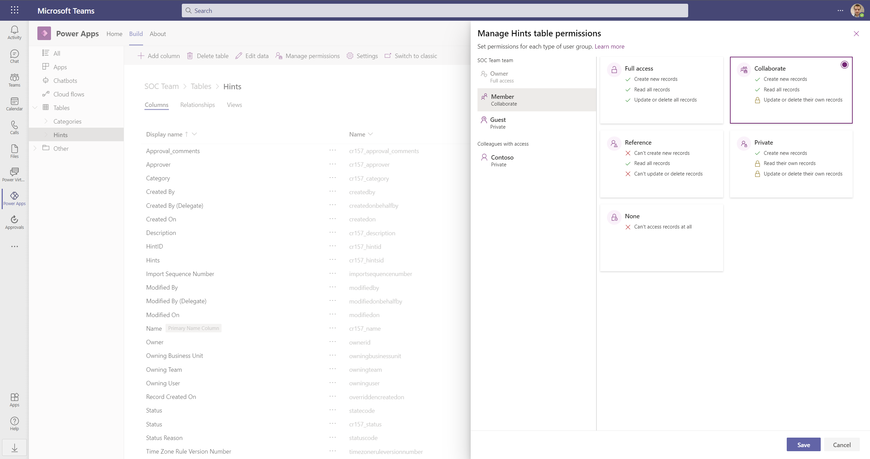



Built in security and governance
Microsoft Dataverse for Teams is enterprise grade and designed to work within Teams.
Focused on Teams, it aligns with the core roles identified in that environment, eg. Owners, Members, and Guests.
Access to the environment is restricted just to the Teams owners, members and guests
Ability to assign different security role to Teams Owners and Members. No security settings management for Business Unit and Teams is required.

Slide 8
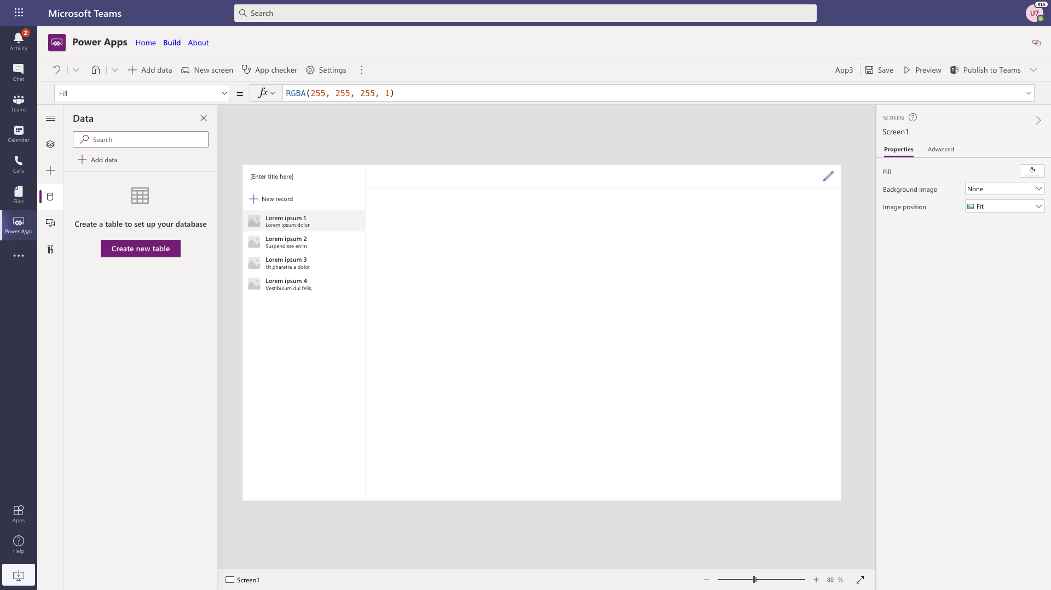
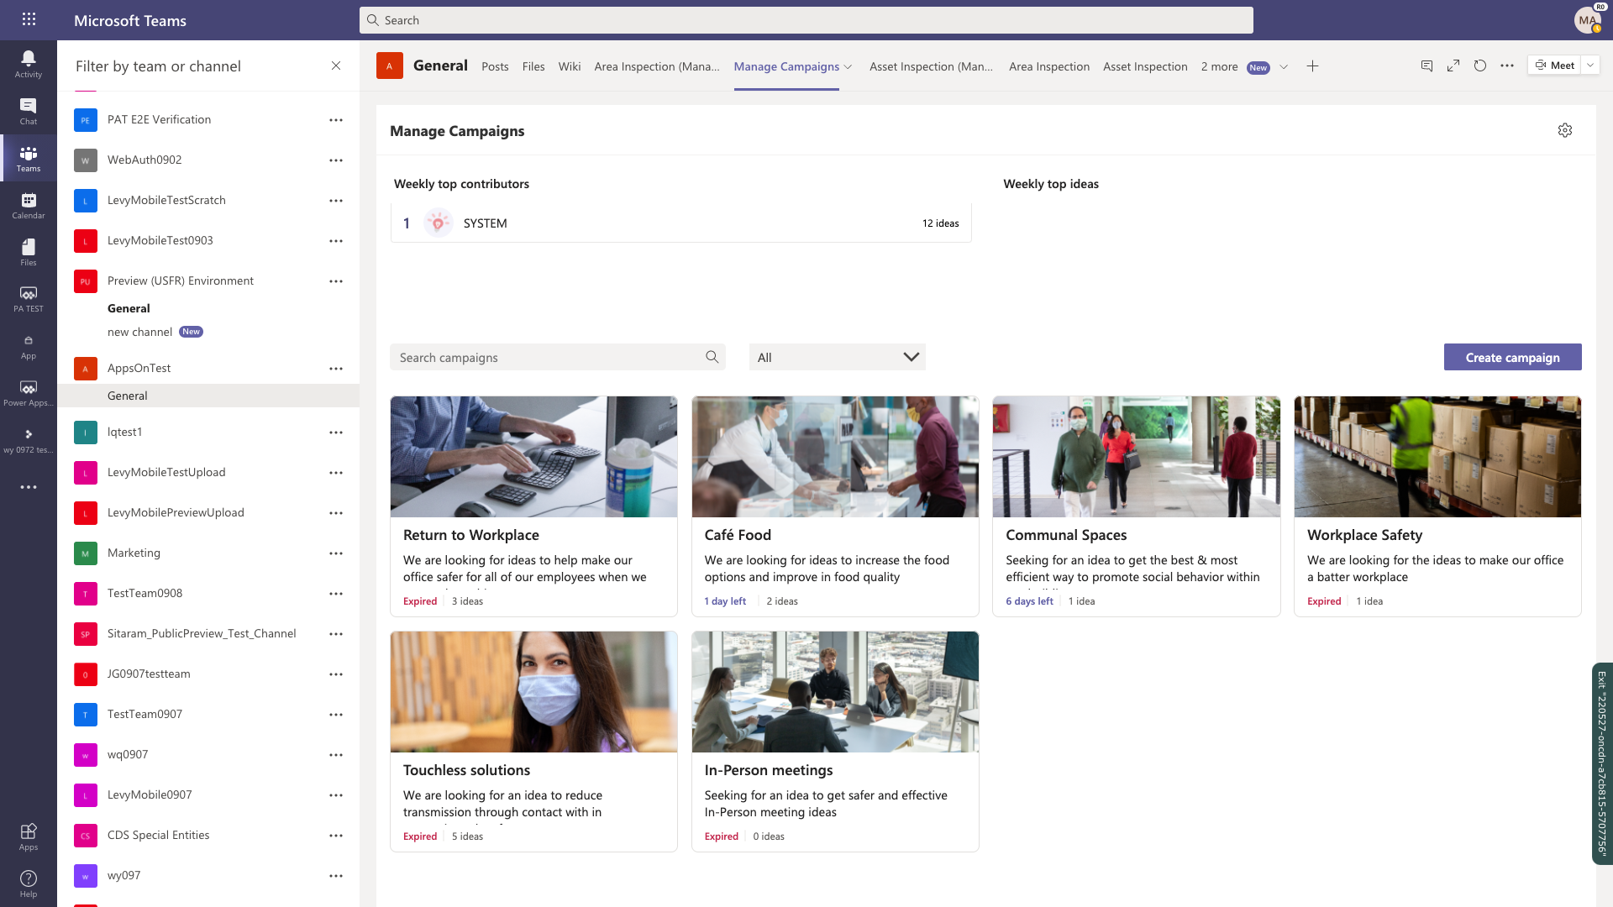
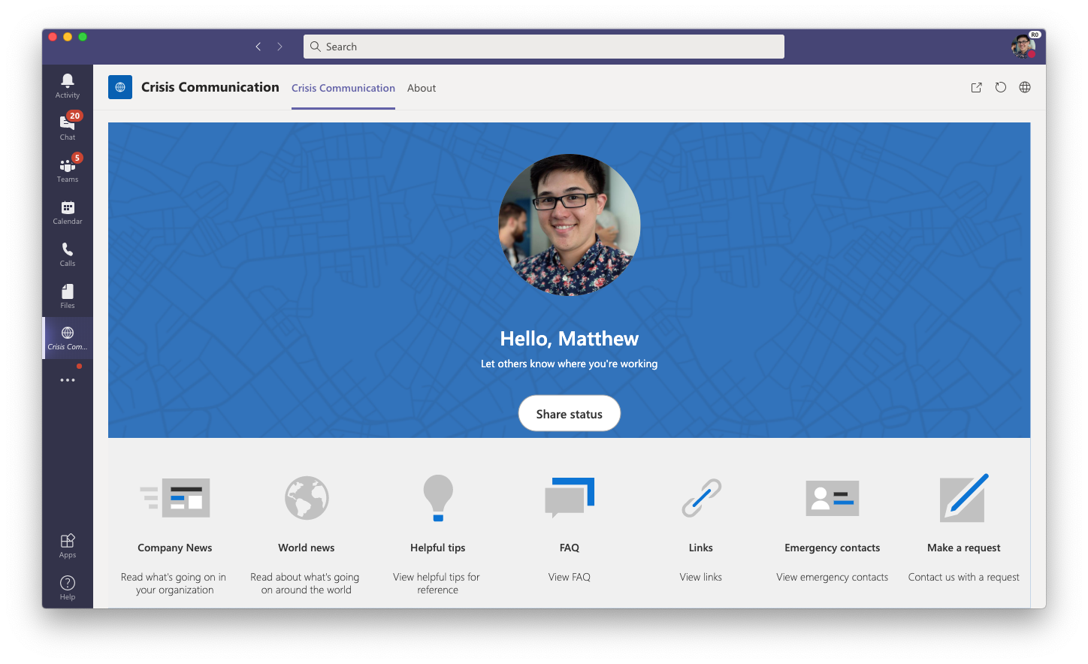
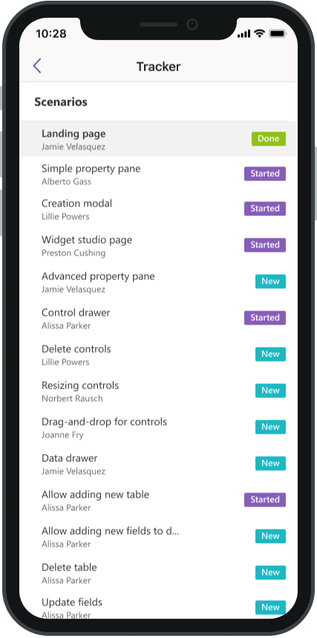
Apps for Everyone
Personal apps
Team apps
Organizational apps
Build apps for a single user for personal productivity.
Develop and deploy solutions for a single team to increase team collaboration.
Roll out org-wide enterprise apps to digitally transform your company.
Citizen developers
Central IT and departments

Slide 9


Teams can shape the future of work with an embedded low-code development platform
Simple to build
Teams-native maker experience.
Connected solution back-end.
Solution templates to help get started.
A low-code custom development platform for Teams users to run business processes.
Seamless to deploy
One-click deployments to Teams app store.
Simple for partners to build/deploy solutions for customers.
Smooth mobile experience to help serve first line workers.
Streamlined deployment process and in-Teams discovery to make solutions broadly available.
Easy to manage
Usage telemetry available to Teams Admins.
Teams capabilities included with Microsoft 365 licenses.
Clear governance and licensing model to help Admins feel comfortable.

Slide 10

Limits & Details
Dataverse for Teams is available as part of select Microsoft 365 subscriptions with Microsoft Power Platform and Microsoft Teams capabilities, excluding plans for US government, EDU A1 and SUB SKUs.
Free to use inside Microsoft Teams using only free functionalities.
No direct API to access data in Dataverse for Teams
Not available in GCC/ GCC High
Max 2GB storage
Simple security, no security roles

Slide 11
Let’s see it in action!
Notes:
Vesa

Slide 12
Our Sponsors
GOLD
COMMUNITY

Slide 13


